Slide 1
Lecture 14
Logistics
  Midterm 1: Average 90/100. Well done!
  Midterm solutions online
  HW5 due date delayed until this Friday
Last lecture
  Finished combinational logic
  Introduction to sequential logic and systems
Today
  Memory storage elements
    Latches
    Flip-flops
  State Diagrams

Slide 2
Example from last time
Door combination lock
  Enter three numbers in sequence and the door opens
  As each number is entered, press ‘new’
  If there is an error the lock must be reset
  After the door opens the lock must be reset
  Inputs: Sequence of numbers, reset, new
  Outputs: Door open/close
  Memory: Must remember the combination
  Memory: Must remember which state we are in

Slide 3
The “WHY” slide
Memory storage elements
  In order to do fun problems like the door combination lock, we must know the building blocks (like how you had to learn AND and OR before you could do functional things). Be patient --- once you know these elements, you can build a lot of meaningful functions
State diagrams
  For combinational logic, truth table was an invaluable visualization tool for a function. For sequential logic, state diagram serves as a way to visualize a function.

Slide 4
How do we store info? Feedback
Two inverters can hold a bit
  As long as power is applied
Storing a new memory
  Temporarily break the feedback path
"1"
"0"
"stored bit"
"remember"
"load"
"data"
"stored bit"

Slide 5
The SR latch
Cross-coupled NOR gates
  Can set (S=1, R=0) or reset (R=1, S=0) the output
S R Q
0 0 hold
0 1 0
1 0 1
1 1 disallow
Reset
R
Q
Set
S
Q

Slide 6

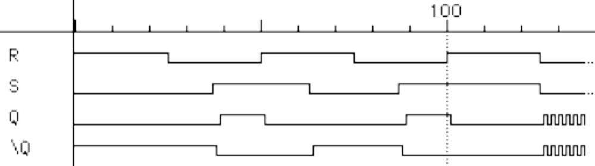
SR latch behavior
NOR output is 1
Only when both inputs are 0
Truth table and timing
S R Q
0 0 hold
0 1 0
1 0 1
1 1 disallow
R
Q
S
Q'
Reset
Hold
Set
Reset
Set
100
Race
R
S
Q
Q'

Slide 7
SR latch is glitch sensitive
Static 0 hazards can set/reset latch
  Glitch on S input sets latch
  Glitch on R input resets latch
0
R
Q
S
Q'
0

Slide 8
State diagrams
How do we characterize logic circuits?
  Combinational circuits: Truth tables
  Sequential circuits: State diagrams
First draw the states
  States ≡ Unique circuit configurations
Second draw the transitions between states
  Transitions ≡ Changes in state caused by inputs

Slide 9
Example: SR latch
Begin by drawing the states
  States ≡ Unique circuit configurations
  Possible values for feedback (Q, Q')
SR=10
S R Q
0 0 hold
0 1 0
1 0 1
1 1 disallow
SR=00
SR=01
SR=00
SR=10
Q Q'
0 1
SR=01
Q Q'
1 0
SR=01
SR=10
SR=11
Q Q'
0 0
R
Q
SR=11
SR=11
SR=00
SR=11
SR=00
Q'
SR=01
SR=10
S
possible oscillation
between states 00 and 11
(when SR=00)
Q Q'
1 1

Slide 10
Observed SR latch behavior
The 1–1 state is transitory
  Either R or S “gets ahead”
  Latch settles to 0–1 or 1–0 state ambiguously
  Race condition → non-deterministic transition
    Disallow (R,S) = (1,1)
SR=10
R
Q
SR=00
SR=01
SR=00
SR=10
Q Q'
0 1
Q Q'
1 0
S
Q'
SR=01

Slide 11
The D latch: store it and look it up
Output depends on clock
  Clock high: Input passes to output
  Clock low: Latch holds its output
Latches are level sensitive and “transparent”
Input
D
Q
Output
Q
Output
CLK
CLK
D
Q_{latch}

Slide 12
The D flip-flop
Input sampled at clock edge
  Rising edge: Input passes to output
  Otherwise: Flip-flop holds its output
Flip-flops can be rising-edge triggered or falling-edge triggered
Input
D
Q
Output
Q
Output
CLK
CLK
D
Q_{ff}

Slide 13
The D flip-flop
Input
D
Q
Output
Q
Output
CLK
CLK
D
Q_{ff}

Slide 14
The D latch
Input
D
Q
Output
Q
Output
CLK
CLK
D
Q_{latch}

Slide 15
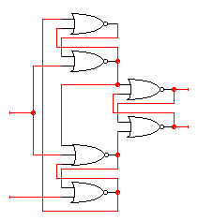
How do we make a D flip flop?
Edge triggering is difficult
  You can do this at home:
    Label the internal nodes
    Draw a timing diagram
    Start with Clk=1
W
X
Q
Clk
Q’
Y
Z
D

Slide 16
How do we make a D flip flop?
Falling edge-triggered flip-flop
If Clk=1 then X=Y=0 and SR-latch block
holds previous values of Q,Q’
also Z=D’ and W=Z’=D
W
X
When Clk→0 then Y (set for SR-latch block)
becomes Z’=D
and X (reset for SR-latch block)
becomes W’=D’
so Q becomes D
This is stable until D or the Clk switches
Q
Clk
Q’
Y
Z
D
While Clk=0, if D switches then Z becomes 0 and
X and W hold their previous values and Y=X’=D as before.

Slide 17
Terminology & notation
Rising-edge triggered D flip-flop
Positive D latch
Input
D
Q
Output
Input
D
Q
Output
Q
Output
Q
Output
CLK
CLK
Falling-edge triggered D flip-flop
Negative D latch
Input
D
Q
Output
Input
D
Q
Output
Q
Output
Q
Output
CLK
CLK

Slide 18
Latches versus flip-flops
D
Q
CLK
D
Q_{ff}
Q_{latch}
Q
CLK
D
Q
Q
CLK
behavior is the same unless input
changes while the clock is high

Slide 19
The master-slave D
Master D latch
Slave D latch
X
Input
D
Q
D
Q
Output
CLK

Slide 20
T flip-flop
Full name: Toggle flip-flop
Output toggles when input is asserted
  If T=1, then Q → Q' when CLK ↑
  If T=0, then Q → Q when CLK ↑
Input
Q
Input(t) Q(t) Q(t + Δt)
T
Q
>
0
0
0
0
1
1
CLK
1
0
1
1
1
0

Slide 21
Clear and preset in flip-flops
Clear and Preset set flip-flop to a known state
  Used at startup, reset
Clear or Reset to a logic 0
  Synchronous: Q=0 when next clock edge arrives
  Asynchronous: Q=0 when reset is asserted
    Doesn't wait for clock
    Quick but dangerous
Preset or Set the state to logic 1
  Synchronous: Q=1 when next clock edge arrives
  Asynchronous: Q=1 when reset is asserted
    Doesn't wait for clock
    Quick but dangerous

